Slide 1
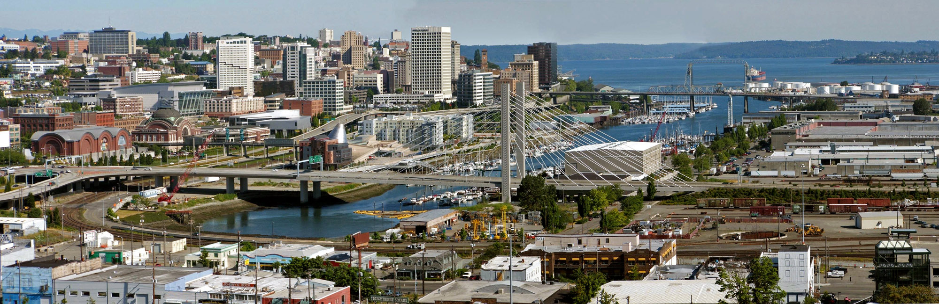
Urban (City) Planning
Career Day
[Name of] School
Date
[Presenter Name]
[Work place]
Note: This presentation may only be used for
non-commercial, educational purposes. Any other use is strictly prohibited

Slide 2
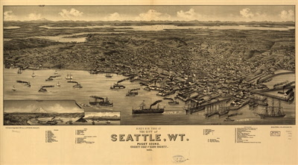
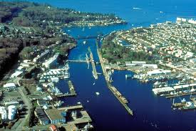
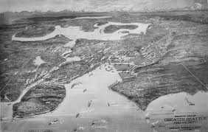
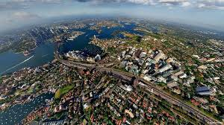
Career Day—Urban Planning
Then
Now

Slide 3
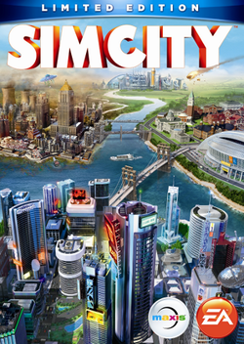
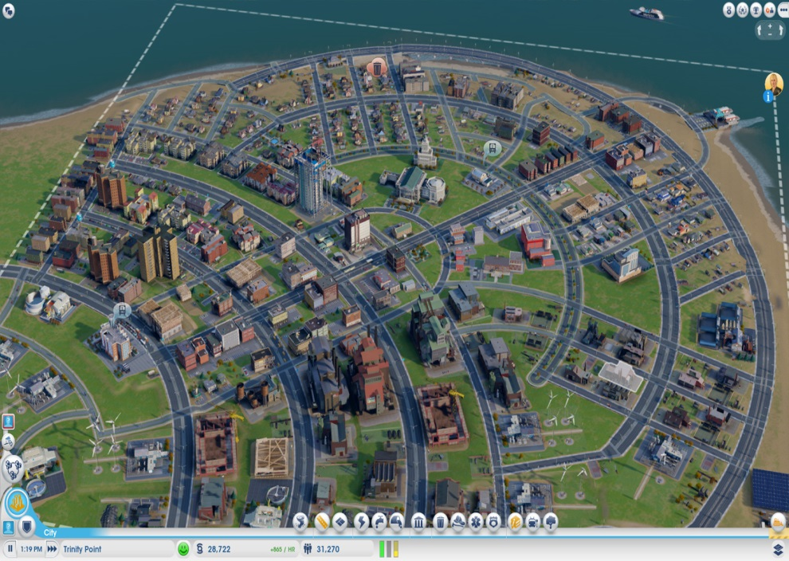
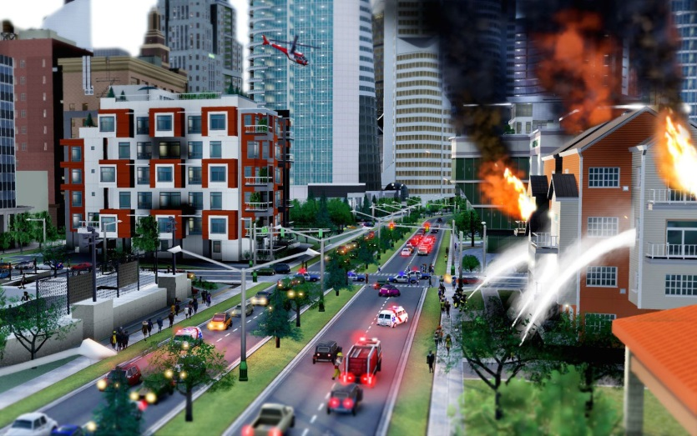
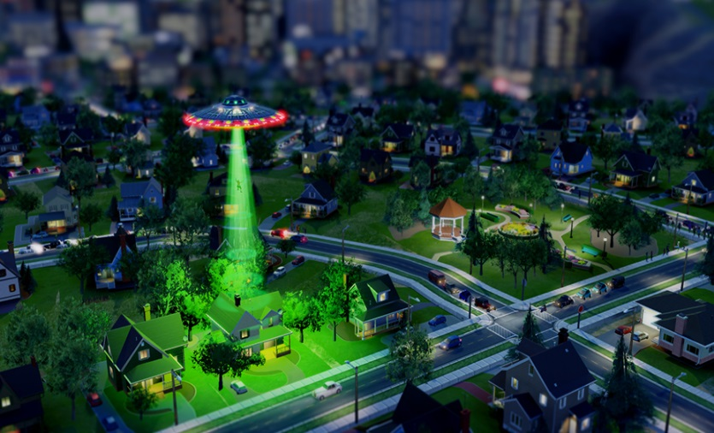
SimCity…but more complicated

Slide 4
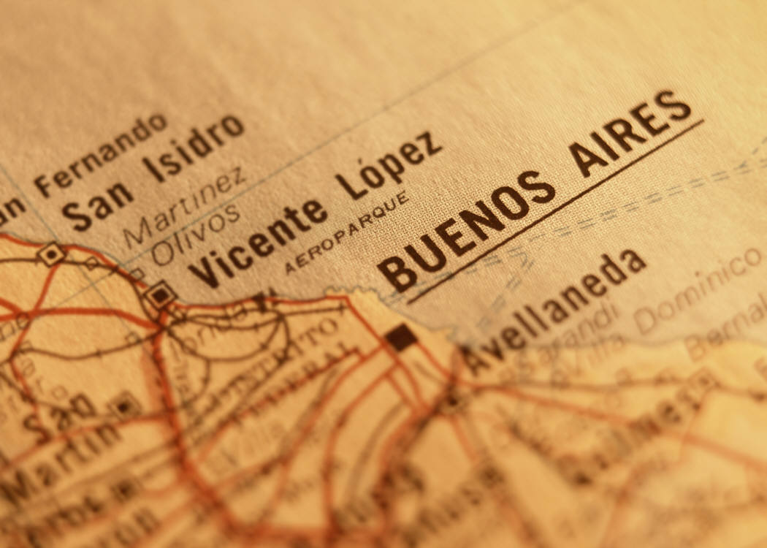
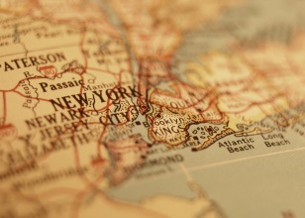
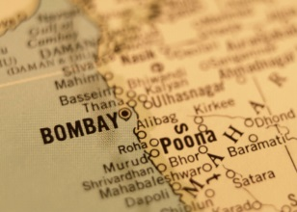

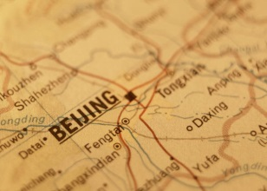
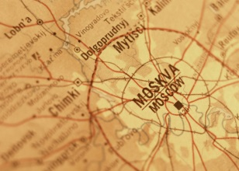
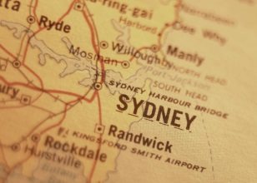
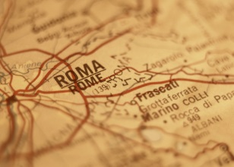
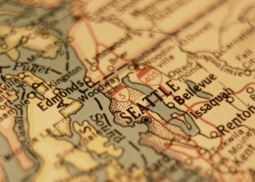
4
Career Day—Urban Planning
Urban planners need to figure out the highest and best use of land and the environment
Planners must balance many things:
housing, jobs and schools, traffic, parks, farms, open space, places to do every day things, have fun
And also protect the environment: air, water, and nature
Planners make new plans when more people move into a community or are expected to.
Before making plans for a community, planners
need to know where everything is
and how things are being used
Planners out how many people use the streets, highways, water, sewers, schools, libraries, museums, and parks. Planners listen to the advice of people
who live in the communities.

Slide 5
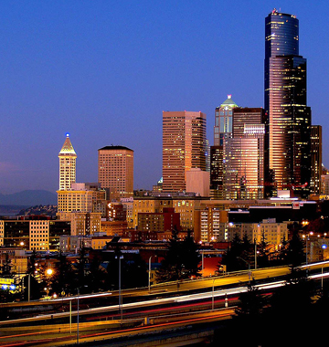
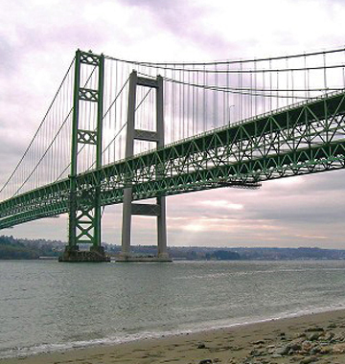
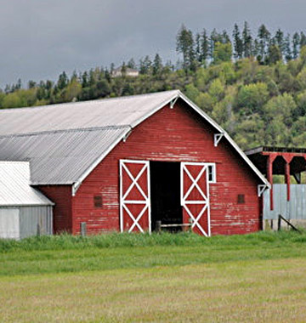
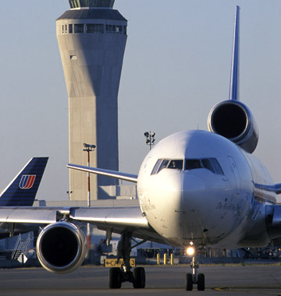
5
Career Day—Urban Planning
Cities have certain things in common:
Where people live with other people
Jobs, Schools, Hospitals, Places for Art Culture and Sports, Parks
Shops and Markets
Industry (where things are made)
Transportation Systems (cars, buses, trains, ferries)
But cities aren’t all the same:
Geography
Number of people living there
Culture
Climate
Build-able land
Coastal, Inland
History, Age of the city

Slide 6
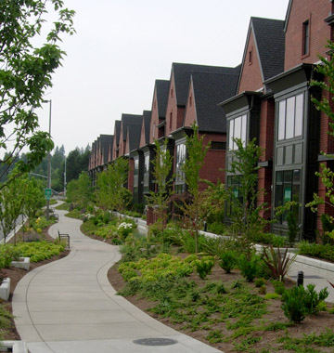
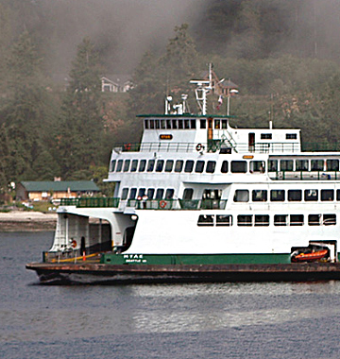

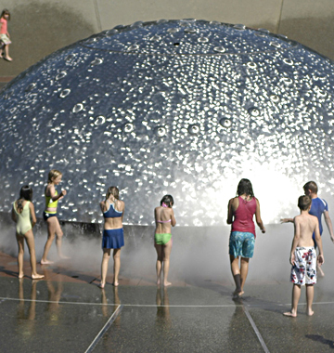
City Planners need to answer these questions
LIVING
Where do people live? In what types of houses?
WORKING & GOING TO SCHOOL
Where do people work? What are their jobs?
Where do students go to school?
TRAVELING
How do people get around their neighborhoods?
Get to work? Travel?
HAVING FUN
What do people do for fun? Indoors? Outdoors? Parks?
Stadiums? Museums?

Slide 7
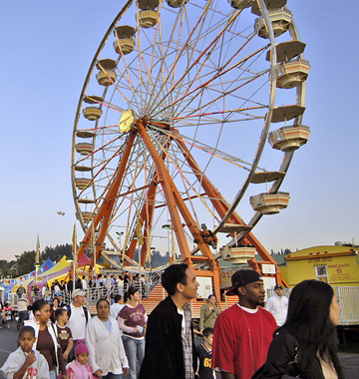
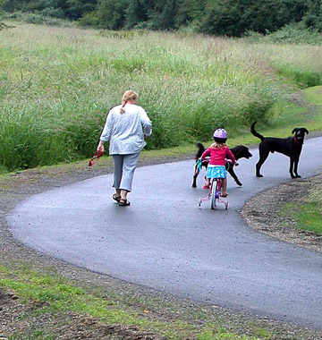
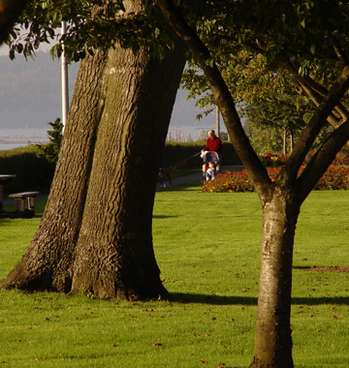
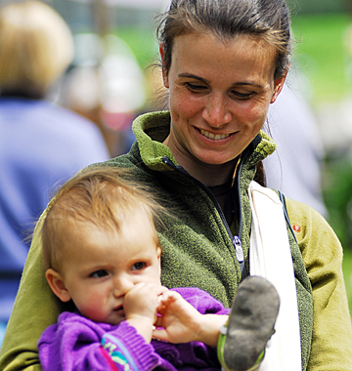
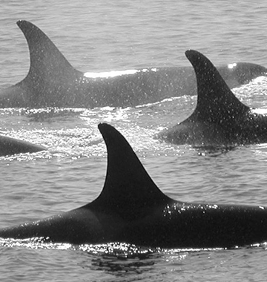
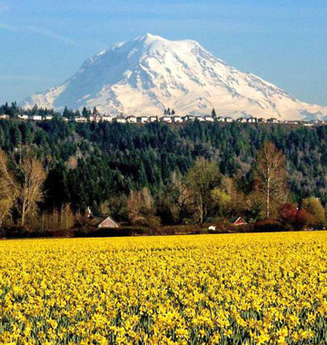
City Planners need to answer these questions, too:
Where does water for drinking come from?
How can we keep our air clean?
Where will garbage, sewage, and recycling go?
Where will we grow good, healthy food?
Where will more people and jobs go?
Are new technologies needed?

Slide 8
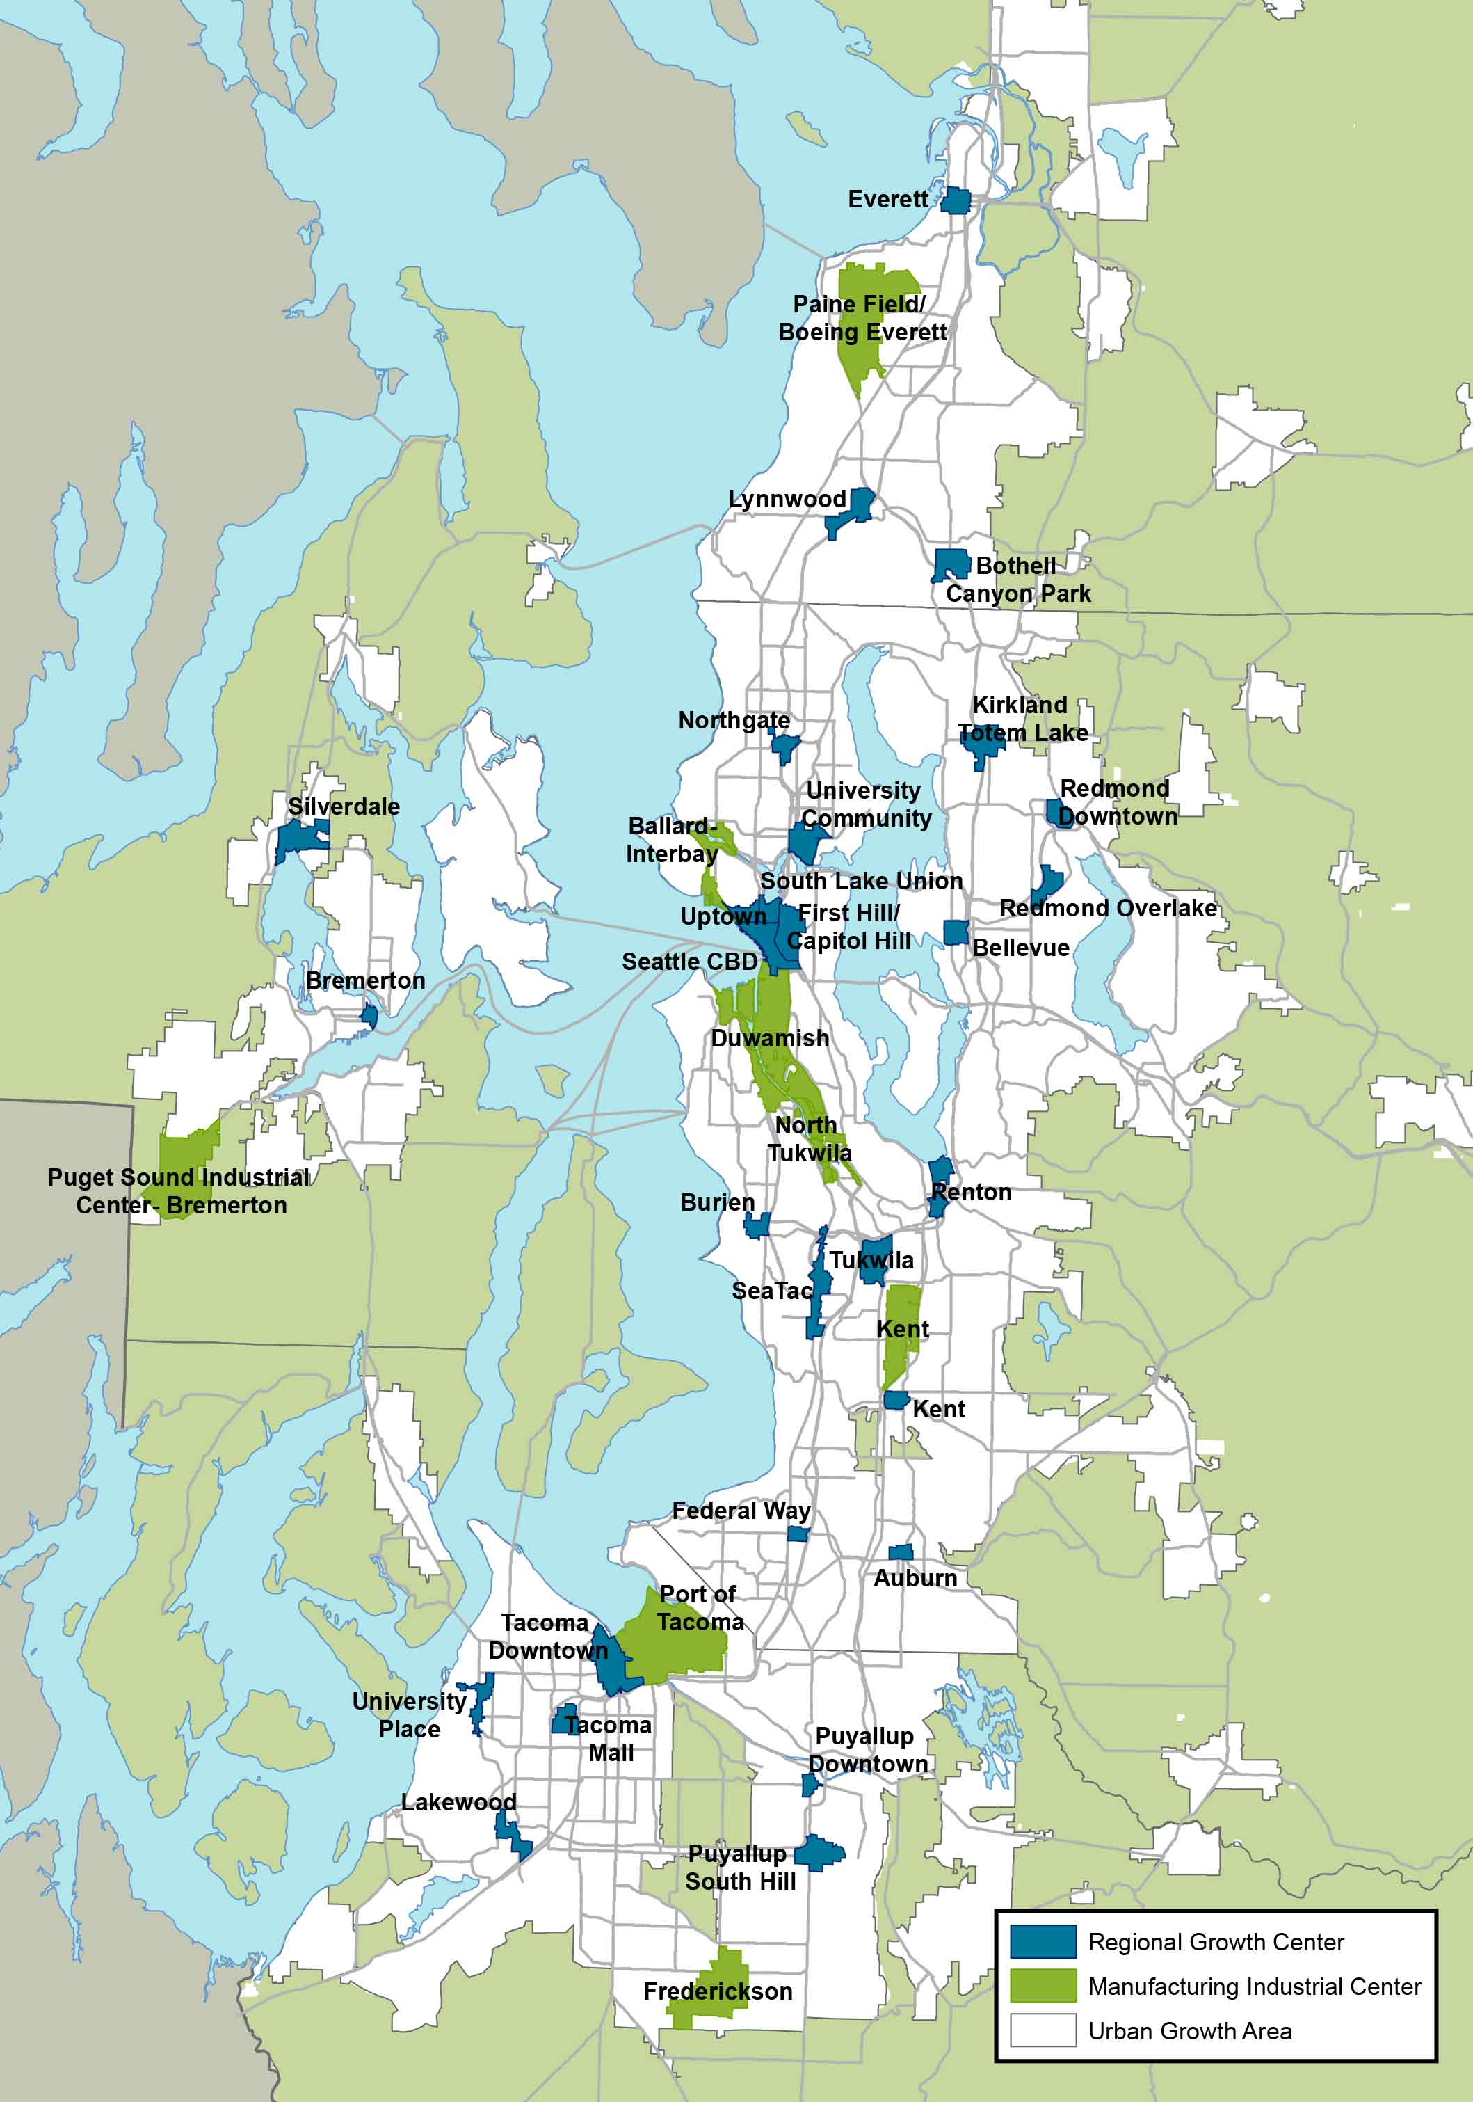
8
Career Day—Urban Planning
What is going on where we live?
Lots of people want to live and work here
[examples]
Housing, schools, services, transportation
[examples]
Protect the environment
[examples]

Slide 9

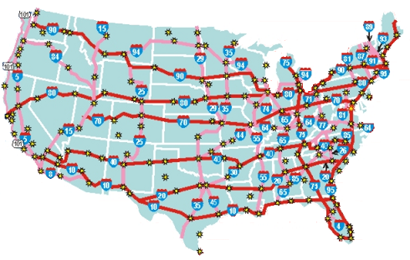
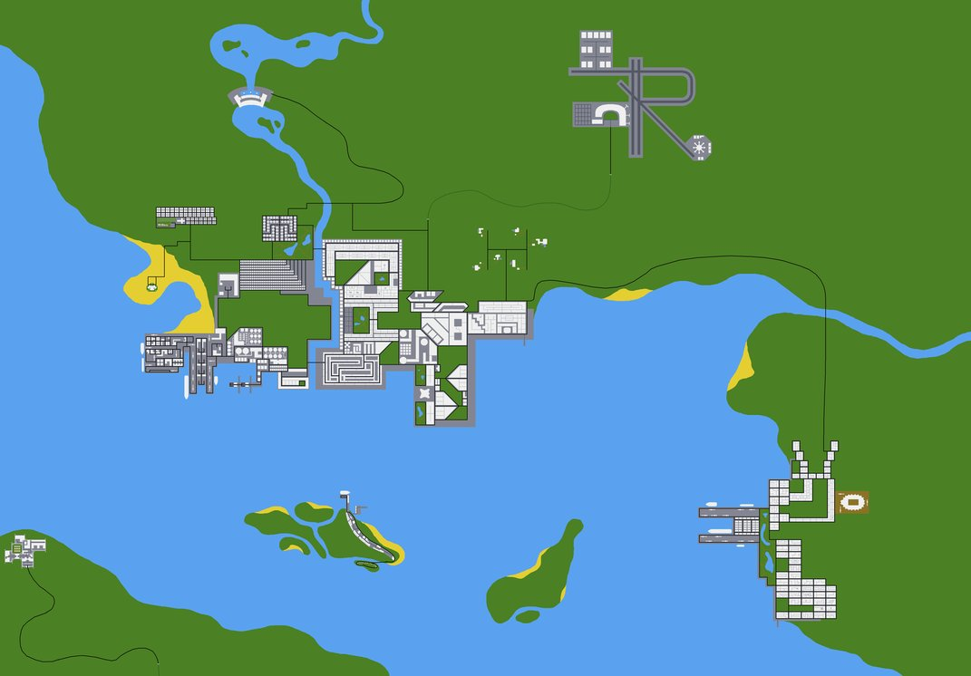

Planning as a Profession
Make communities—and the lives of all those who live in them—better
Visionary—see alternative ways of doing things
Strategic thinker—connect the dots
Good people skills and
Recognize multiple points of view
Analyze all types of information
Problem-solver

Slide 10
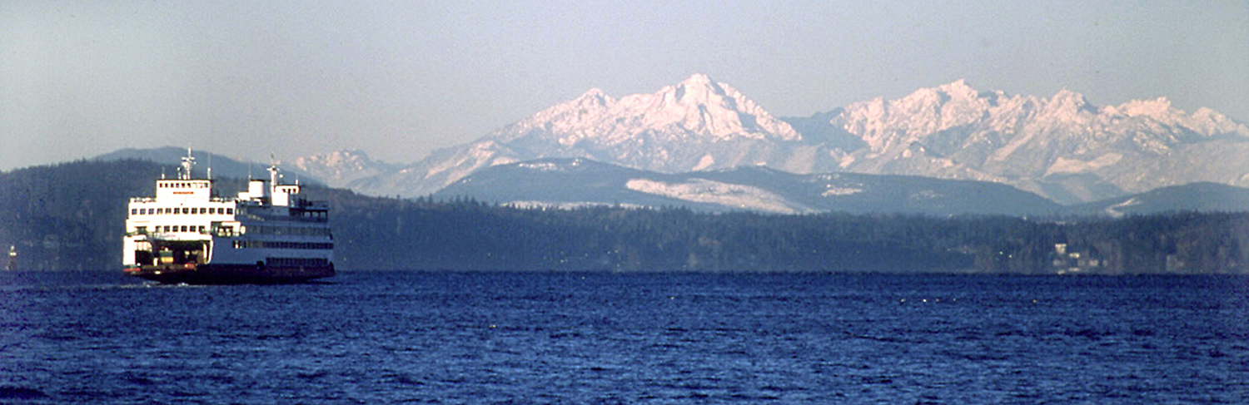
Questions?
THANK YOU!
[name, etc.]

