Slide 1

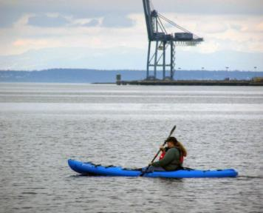
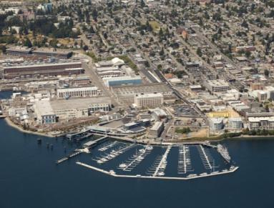
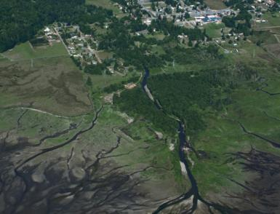
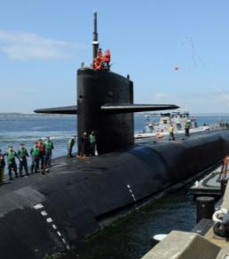
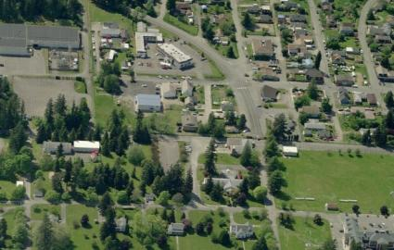

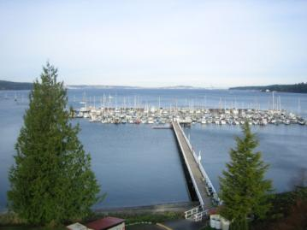
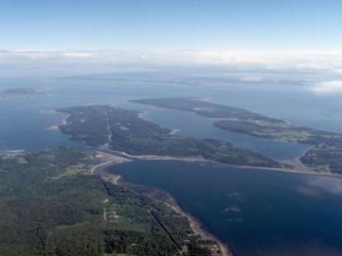
  www.kiijlus.com
Kitsap County ▪ Jefferson County ▪ City of Bremerton
Naval Base Kitsap ▪ Naval Magazine Indian Island
Notes:
What is a Joint Land Use Study?
Who is involved?
How is this related to planning under the Growth Management Act?
Recommended Strategies, and how we are incorporating them into our Comp Plan and other planning efforts

Slide 2
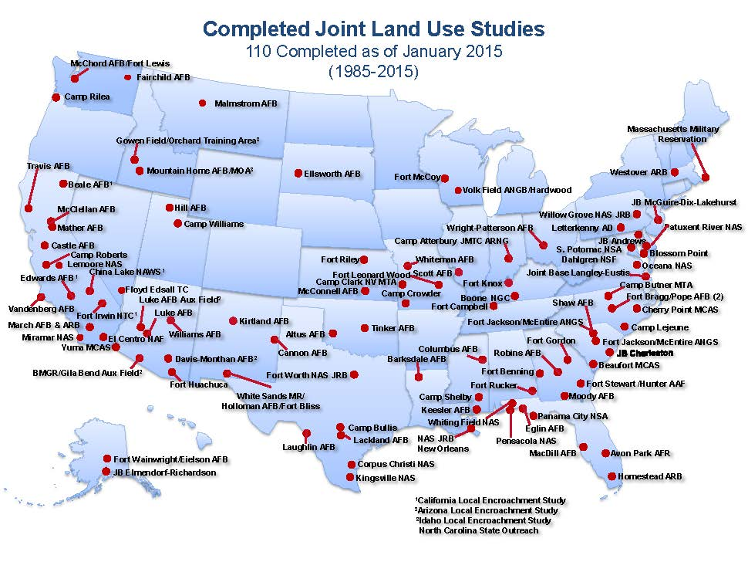
Notes:
Joint Land Use Studies are a standard project designed and supported by the Department of Defense, Office of Economic Adjustment. 110 have been completed over the past 30 years in military communities across the country.

Slide 3
What is a JLUS?
  A federally funded grant program to promote cooperation administered by Department of Defense Office of Economic Adjustment (OEA)
  A proactive and cooperative land use planning effort involving local jurisdictions & military installations
  A study to identify strategies & recommendations for future consideration by local governments
A JLUS is produced by and for the local jurisdiction(s). It is intended to benefit both the local community and the military installation... The JLUS program is a basic planning process designed to identify encroachment issues confronting both the civilian community and the military installation and to recommend strategies to address the issues in the context of local comprehensive/general planning programs.
-Office of Economic Adjustment
Notes:
In recent years, the Navy has become aware of how much land use planning can impact their installations and create conflicts between residents and their operations. One of the ways Navy Region NW has addressed this is by hiring five Community Planning Liaison Officers. They reach out to and work with our local planning staff and elected officials. Through this outreach and with agreement from the local governments, they nominated and funded a Joint Land Use Study to help ensure proactive cooperation and compatible planning around Naval Base Kitsap and Naval Magazine Indian Island.
A JLUS is a body of information that supports informed decision making. One thing that the OEA stresses is that this study is produced BY and FOR the local jurisdiction….so its not a NAVY project.
Its also NOT:
Directly change any land-use decisions or requirements (no new zoning provisions will be adopted by accepting this phase of the document)
Authorize or evaluate any new military activities (Navy would need EIS/NEPA process)
Evaluate individual projects or actions (like EHW-2 or large private projects)

Slide 4
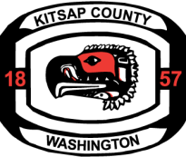

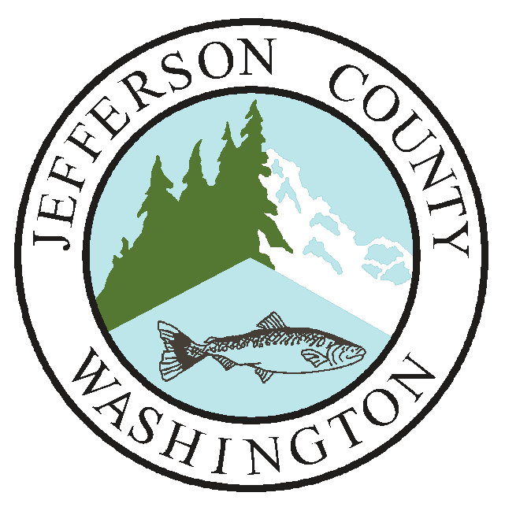
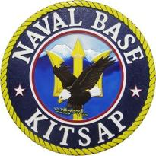





Project Partners
Consultant Team
Notes:
Kitsap County, DCD became the JLUS sponsor in 2014, in partnership with Jefferson County, the City of Bremerton and the Navy (specifically, Naval Base Kitsap and Naval Magazine Indian Island). We were required to have most of the work be done by a consultant team, so we hired a local firm (Makers) and their subs to complete the work.

Slide 5
JLUS Partners & Involvement
Participants
Sponsor
Kitsap County
Public Officials
Local / County / Tribal
Other Agencies
Military Representatives
Policy
Committee
Planning Staff
Engineering Staff
Technical Specialists
Other Key Stakeholders
Technical
Committee
Public
All interested persons
Notes:
Who?- Already talked about how Kitsap County was selected as the project sponsor.
There are a Policy Committee (oversight- consists of public officials, tribal and military leadership) and Technical Committee (staff level from same groups, also has included state agencies).
And of course the public- The County has an electronic notification system, so we set one up specifically for JLUS. We also did an early push on Facebook, which had a tremendous affect on the number we reached, but also (as you would probably imagine) a MUCH different demographic. We really strove to make this process transparent and accessible. We had a stand-alone website, posted videos from all the open house/workshop presentations, and gave ample review periods at multiple phases.
To this point we’ve held 10 meetings with the Policy and/or Technical Committee over the last 14 months – and we have one more planned in September with both committees to make final JLUS refinements and formally “accept” the document…..this is different that our usual legislative process that we are used to and DoD does not require any formal resolution or MOU at the end of this phase.

Slide 6
A JLUS is conducted in a collaborative manner involving all stakeholders, including:
Local elected officials
Planning commissioners
Local jurisdiction planning staff
Local military leadership
Military base staff
Community business leaders
Chambers of commerce
Homebuilders
Real estate interests
Environmental interests
Tribal government representatives
Affected residents
Notes:
This is just an abbreviated list of stakeholders- so aside from those already mentioned, we did stakeholder interviews early in the process with state agencies, environmental groups, school districts, ports, etc.

Slide 7
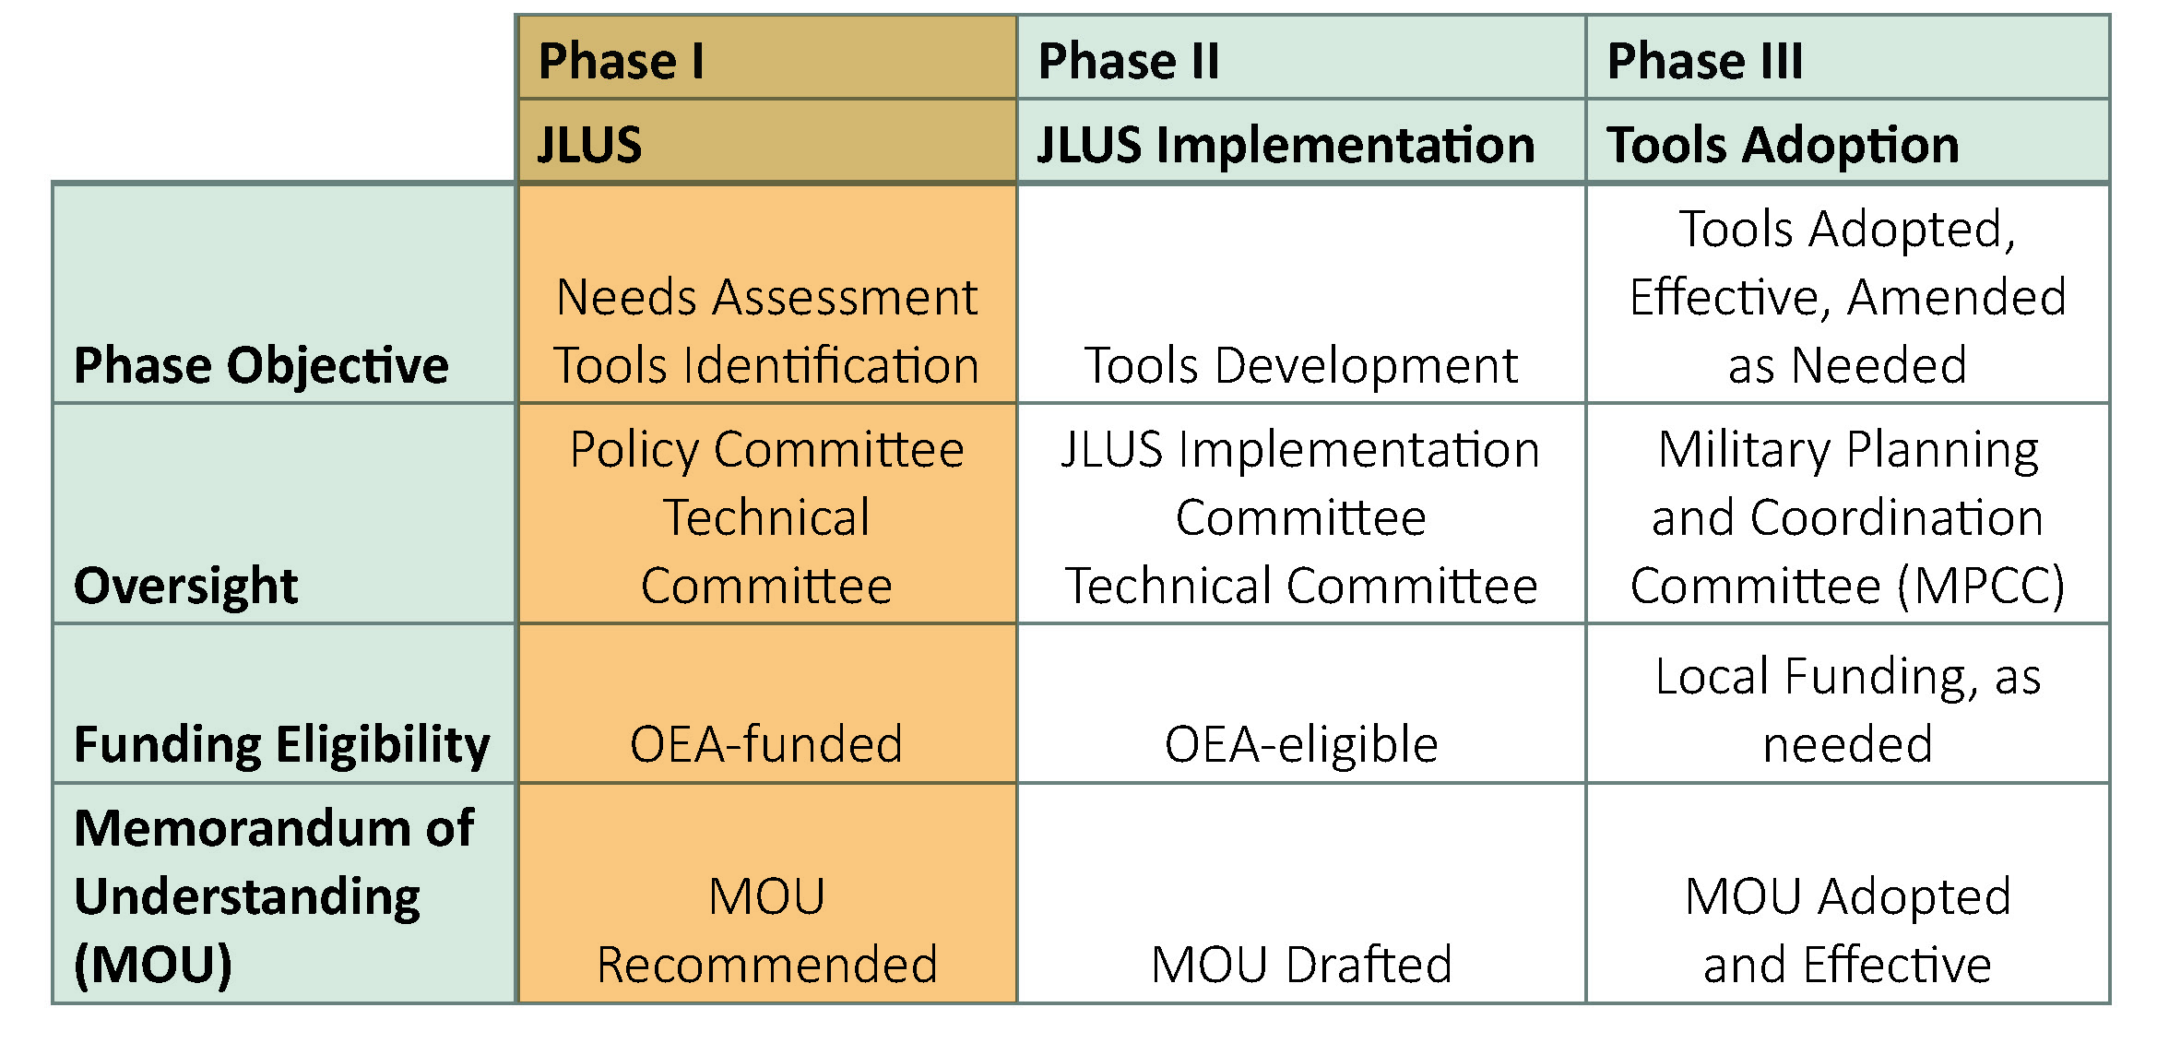
JLUS Implementation Phases
Notes:
I had mentioned phases..
This first phase was simply to IDENTIFY the needs and potential strategies (Example: recommends an MOU)
Each jurisdiction will be able to run with any of the recommendations without additional funding or oversight, we may choose to not move forward, or….
We may elect to move to Phase 2 (which CAN come with additional funding), which will DEVELOP the tools identified in phase 1 (Example: drafts and MOU)
FINALLY, those tools may be ADOPTED or IMPLEMENTED in phase 3 (Example: Adopted MOU)

Slide 8
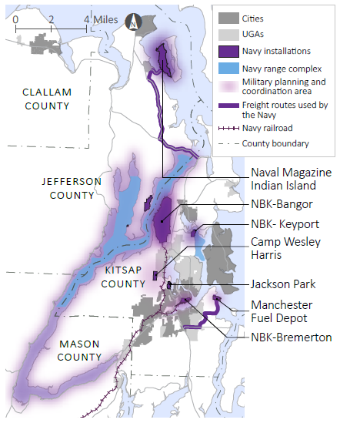
NBK JLUS PROJECT AREA
Naval Base Kitsap
Five Major Local Bases
Bangor
Bremerton
Keyport
Manchester
Jackson Park
Other WA State Parcels
Camp McKean
Camp Wesley Harris
Dabob Bay
Toandos Peninsula
Auburn Warehouse
Remote Properties
SEAFAC, Ketchikan, AK
Two Radio Towers – B.C.
Naval Magazine Indian Island
Military Planning and Coordination Areas
Notes:
For this JLUS, we have a geographically large project area.
Naval Base Kitsap is one of, if not the, most complex bases in the country- based on geographic distribution and scope of missions. Locally, we have:
Bangor
Bremerton (PSNS)
Keyport
Manchester
Jackson Park/Naval Hospital
Multiple other parcels which may not be obvious (both on the Kitsap and Olympic Peninsulas)
Remote properties in Alaska and B.C. also are included in NBK
NAVMAGII
Also includes supply routes, railroad cooridor and range complexes
Does not include military operations based at other installations (NAS Whidbey Island, JBLM, Everett not included)

Slide 9
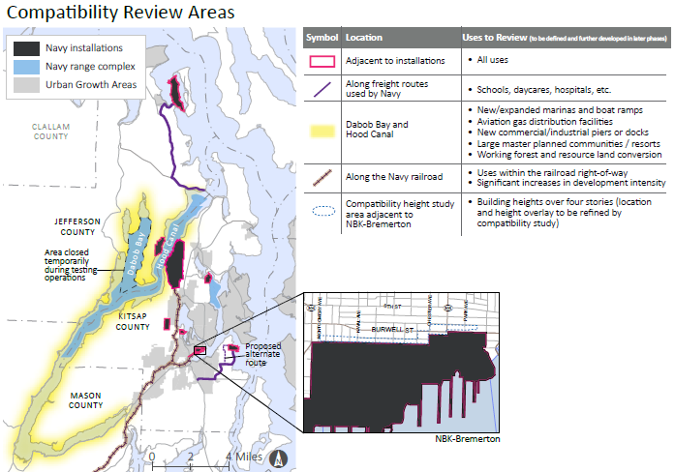
What is compatibility?
Civilian and military land uses that exist harmoniously alongside each other
Compatible uses do not expose people to undue safety risks or nuisance
Compatible uses do not result in interference with military exercises
Notes:
The overall goal of the JLUS is about compatibility….but what does that mean?
It’s a two-way street.
Civilian and military uses can exist alongside each other- so we are looking through the lens of:
Military uses that do not expose people to hazards or nuisances
Civilian uses that don’t interfere with military exercises and mission
Map:
Its not everything, everywhere: We are focusing compatibility planning efforts to the critical geographic areas surrounding NBK and Ranges.
All uses surrounding the actual installations, specific uses were reviewed along freight routes and railroad corridor, and then specific considerations throughout Hood Canal
I’ll get into some of the specific issues later, but I will note that the “what” as far as compatibility was not defined at the start of the JLUS. Part of the processes included working out both the geographic and land use types that need coordination on compatibility.

Slide 10


WHY?
GMA
Economics
Growth
Notes:
To set the stage on why this JLUS process is coming up now and why it is important, I’m going to go over:
Link to GMA and Comp Plan updates
Then go into some of the background provided in the study which also explains why this is important now, including:
The complexity of study area
Economics
And Growth

Slide 11
GMA
RCW 36.70A.530-
Land use development incompatible with military installations not allowed
Kitsap’s County-wide Planning Policies does currently address this RCW (Element M)
Notes:
RCW-
recognizes the economic importance of the military in Washington communities and says that it’s a state priority to protect the land surrounding military installations from incompatible development
Comp plans and development regulations “should not allow development in the vicinity of a military installation that is incompatible with the installations ability to carry out its mission requirements”.
Installation commanders must be notified of any changes (comp plan, develop regs) adjacent and be given 60 days to comment
We’ve been working, through this JLUS, to define those terms for our region, or at least set up a coordination system to work through those questions.
Element M of CPP:
Policies to promote communication and coordination between all jurisdictions, including the military and essentially mirror the RCW.
Several other policies throughout which encourage this

Slide 12
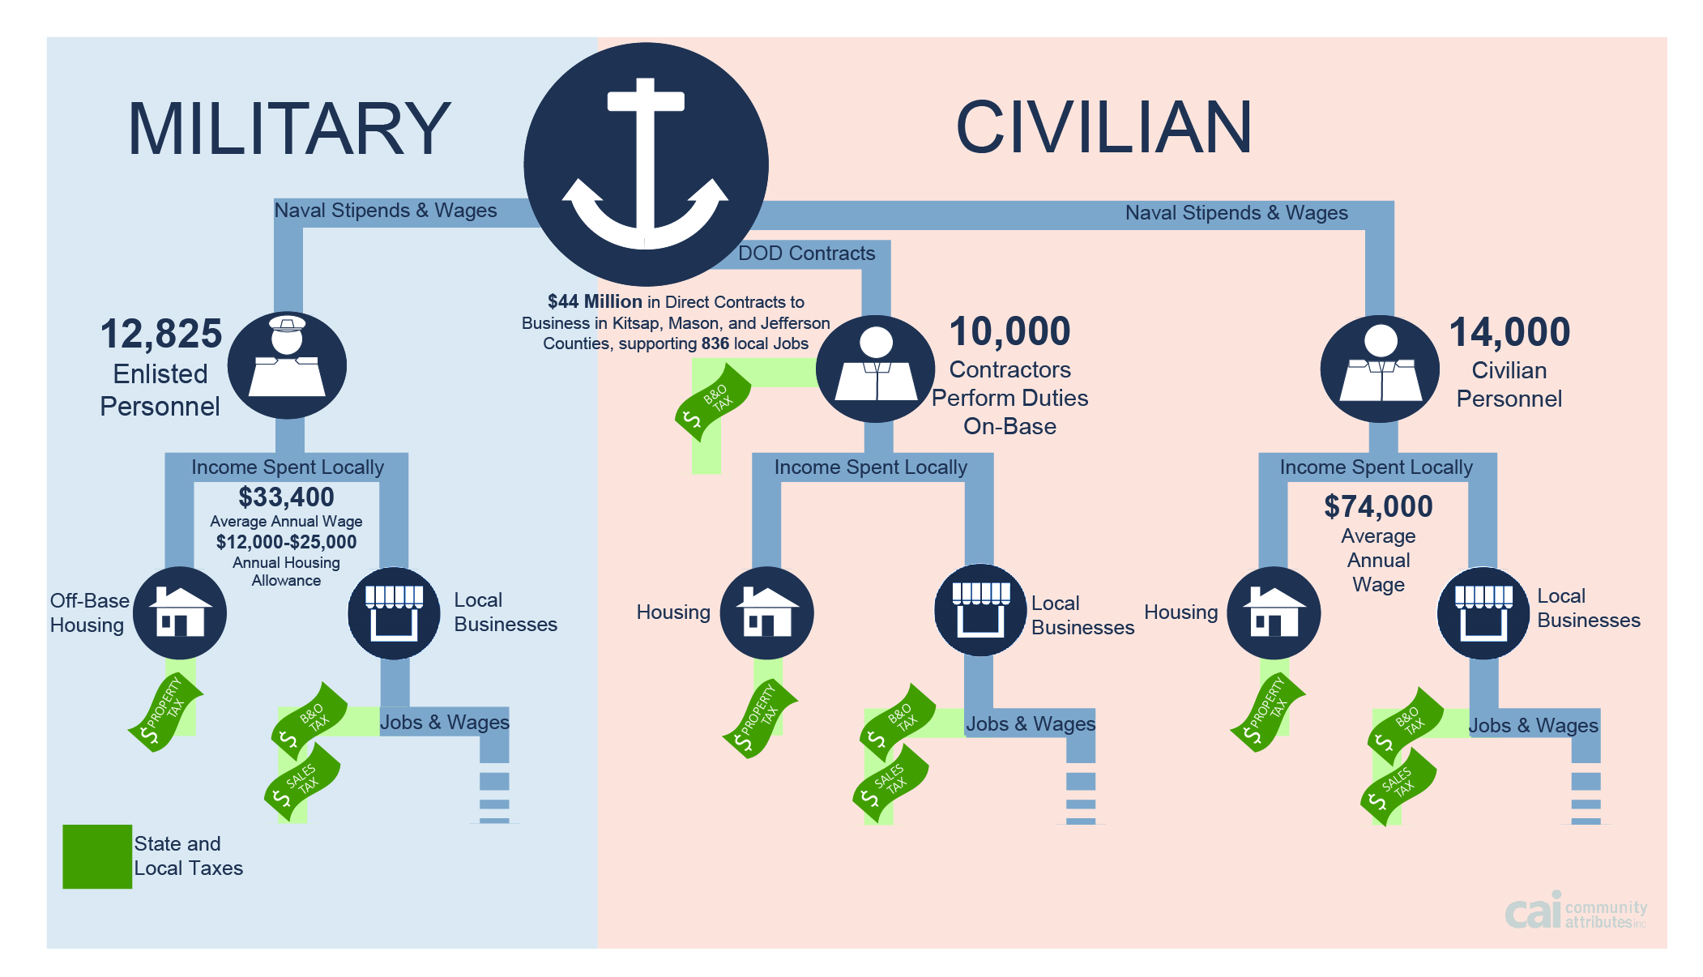
ECONOMICS
$7 billion
in DoD contracts
with WA companies
$4.1 billion
through the Navy
$768 million
in Kitsap County
$67 million
in local company contracts
Notes:
Many of the goals and policies in the County’s Economic element relate to the Navy in some direct or indirect way, as well.
The economic importance of the Navy is obvious to many of us that live here, and we consolidated a lot of information on the topic….to the point that it justified its own appendix. We tried to be as up-to-date as possible, so some of the information is for 2014, but much is from 2011-12.
Jobs- 12,825 enlisted; 10,000 contractors; 14,000 non-contractor civilian personnel
Housing- the BAH often represents the maximum rent allowed for off-base housing; Navy no longer manages any of the local housing, even on-base (more housing for non-military now available that wasn’t before.)
Contracts alone-
$7 Billion DoD to WA companies
$4.1 Billion of that through the Navy
$768 Million within Kitsap County ($67 Million going to local companies)

Slide 13
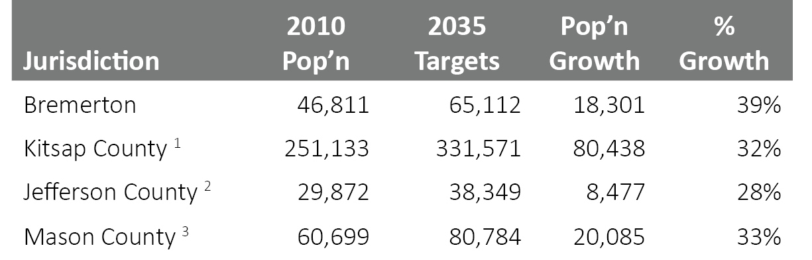
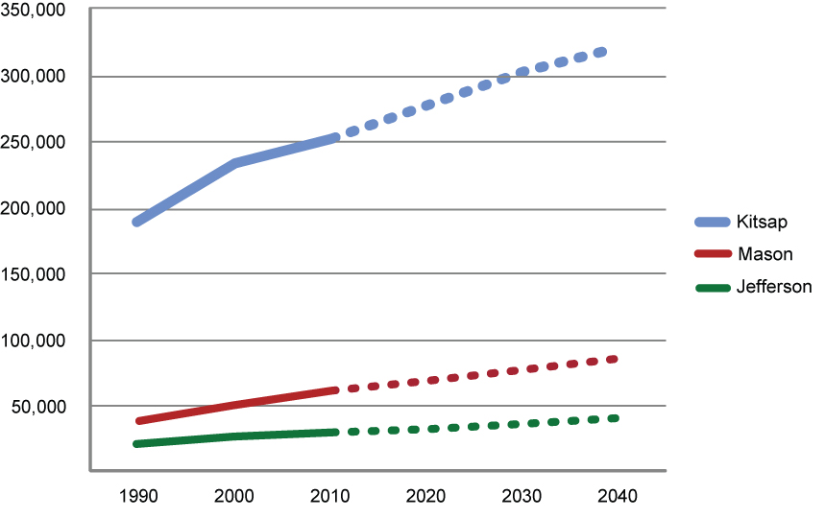
GROWTH
Notes:
Kitsap County is the third smallest county in Washington by area, but is the third most densely populated, with growth expected to increase by nearly 40% over the next 25 year planning horizon.
More people, of course, = Increased potential for land use conflicts
Several NBK facilities, specifically the Dabob testing and trainging range, are essentially irreplaceable and its imperative to national security that those be able to continue.
We need to be aware of where we are planning to place people, expand UGAs, and provide services that would bring large expansion of development into areas of concern such as adjacent to facilities or that would affect training ranges.

Slide 14
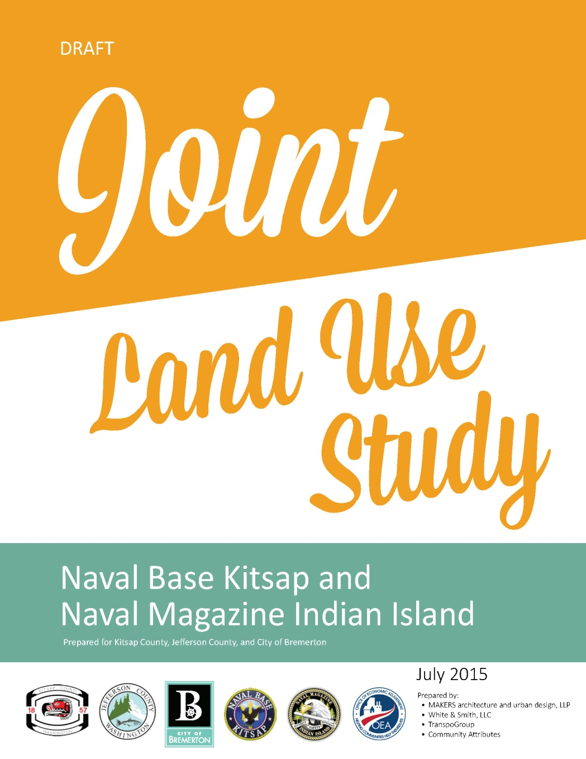
Joint Land Use Study
Input from the Policy & Technical Committees
Input from partner & stakeholder interviews
Online survey results
September ,February, and August public workshops
Research & analysis
Notes:
So, all of this background information was compiled, along with input from the committee members, stakeholders, public surveys and workshops to start piecing together the JLUS.

Slide 15
Report Organization
Introduction
Study Area Profile and Trends
Existing Plans and Programs
Compatibility Analysis
  Communication and Coordination
  Adjacent Land Uses and Infrastructure Coordination
  On-water and Shoreline Activities
  Transportation
  Natural and Cultural Resources
Strategy and Recommendations
Appendices
  Workshop and Survey Results
  Military Economic Impact
  Resources for Implementation
  Strategies and Recommendations by County
Notes:
5 Chapters
First three chapters really cover in much greater detail the background and areas just discussed.
We then moved into a compatibility analysis- public outreach to help identify the “issues”; categorized into 5 areas [see slide]
Finally, we ended with strategies and recommendations for addressing those issues; Each section of this chapter also takes the time to acknowledge and discuss on-going efforts….what is already being done, what is working and what can we build off of. I think that is something we don’t often do in these type of studies. Without it, you tend to lose the context for why you are moving in the direction you are, but also you fail to acknowledge the positives….given that government already has a bad rap, we need to take these opportunities where we can.

Slide 16
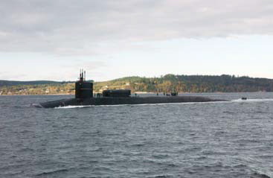
JLUS Strategies & Recommendations
A. Community Outreach by the Navy
Frequent outreach and communication will benefit jurisdictions and the Navy when issues impacting compatibility arise.
Notes:
There are two high priority strategies in this category, which suggest ways to building on the significant outreach and coordination that already occurs.
For example, there’s a recommendation for the Navy to expand updates to elected officials and downloadable fliers summarizing news about the bases to more easily share information. Currently, the base commander gives annual presentations to our Board of County Commissioners on the status of Naval Base Kitsap, called “NBK Today”. This is full of TONS of great information, but is always presented during briefings, which are during the day and rarely attended by the public. The idea here is to get this information out in new ways that make it more accessible to the general public.
The reason that this Strategy is specific to outreach BY the Navy, is that the two-way coordination is peppered throughout the other strategies. These were specific actions the Navy could take to increase mission awareness by officials and the community.

Slide 17
JLUS Strategies & Recommendations
B. Conservation Programs for Protecting Land Use Compatibility
Coordinated land conservation efforts can help preserve priority open spaces and working lands while maintaining compatibility with Navy missions.
Notes:
There are 8 overall strategies in the Conservation Program and Land Protection category, which promotes conservation to help preserve priority open spaces and working lands.
For example, this category includes recommendations to continue conservation and maintaining working lands through Readiness and Environmental Protection Integration (REPI) and other federal, state, local, and private funding; It also includes coordination on climate change issues and identifying areas of mutual interest for conservation of habitat and working lands.

Slide 18
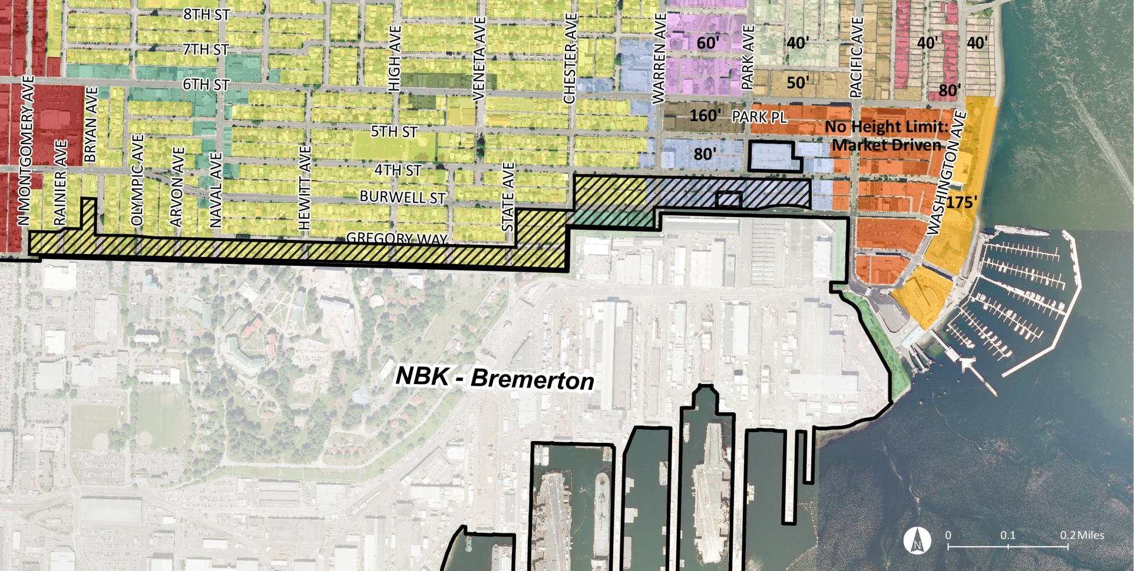
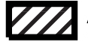
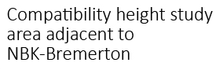
JLUS Strategies & Recommendations
C. Strategic Coordination among Stakeholders
Land use compatibility can be maintained and strengthened through effective coordination between the surrounding communities and the Navy installations.
Example
Notes:
The Strategic Coordination among Stakeholders category addresses coordination to protect land use compatibility.
This is a big one, there are 9 recommendations in the category.
For example,
The JLUS recommends completing a compatibility height study within a small area along the northern perimeter of NBK-Bremerton noted in the graphic.
The purpose of the study would be to better understand and proactively avoid incompatible land uses/national security concerns before they occur.
The study would identify where buildings over 4-stories could potentially create security concerns.
Then, based on the study’s results, the City of Bremerton would consider adopting a height overlay district within a portion of that study area.
Development of a formal MOU and coordination on growth-inducing infrastructure (where new sewer is going in) is another priority example

Slide 19
JLUS Strategies & Recommendations
D. Regional Land Use Planning
Coordination and planning at a regional scale allows for a proactive approach to reduce potential land use issues.
Notes:
The Regional Land Use Planning category looks at improving coordination around regional systems like transportation.
For example, it suggests indicating existing freight routes used by the Navy in regional transportation plans and undertaking design studies before new routes are formally identified.
Involvement of the Military Planning Committee (JLUS) in the Washington Military Alliance

Slide 20

JLUS Strategies & Recommendations
E. Local Government Comprehensive Planning
Considering JLUS goals and suggested strategies in comprehensive plan updates will help avoid future potential land use conflicts.
Notes:
There are 6 overall strategies in Local Government Comprehensive Planning category, which suggests considering JLUS recommendations and goals as local governments update their comp plans.
Comprehensive Plan Goals and Policies (essentially, a semi-formal way of agreeing to consider to move forward with the recommendations of the JLUS)

Slide 21
Comprehensive Plan Incorporation Examples
Land Use Goal:
Implement the strategies and recommendations of the NBK Joint Land Use Study, as directed by the JLUS Implementation Committee.
Policy:
Participate in the Joint Land Use Study (JLUS) Implementation Committee
Potential Strategies:
Develop MOUs or other formal agreements which facilitate formation and continuation of the JLUS Implementation Committee and various strategies as needed.
Map shared interest areas (County and Navy) to identify specific areas, projects or design features (height) which will facilitate a more efficient and effective communication process with the Navy or planned or proposed land use actions.
Share existing data bases and mapping files to facilitate planning, project review and infrastructure development and maintenance.
Participate in the Washington Military Alliance.
Notes:
No obligation. Each jurisdiction can move forward with recommendations individually. The policy committee will be discussing and deciding next Tuesday whether to pursue additional grant funding from OEA into the Phase 2, Strategy Development. That would likely include applying for a traffic and parking study and developing the details of an MOU. The same individuals would also likely be included in the Implementation Committee as were in the PC/TC groups.
There is no deadline to move forward, but like all plans, the background information has a useful life-span, so we hope to know by the end of this year.
Getting the JLUS-related Goals and Policies through the Comp Plan process is also a next step, but we don’t expect there will be any issues with that.

Slide 22
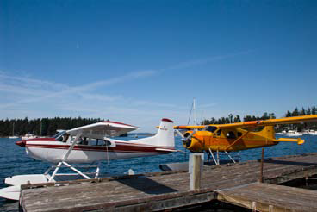
JLUS Strategies & Recommendations
F. Land Use & Development
Formalizing systems to identify potential projects of concern and amending some development regulations could help avoid land use issues before they occur.
Notes:
There are 7 strategies in the Land Use and Development category, which suggests improved coordination and potential land use modifications to help ensure compatibility.
For example,
There is the misconception that the Navy is trying to prohibit use of existing boat ramps or stop development around Hood Canal and Dabob Bay. This section recommends that the Navy and local jurisdictions coordinate when certain kinds of projects (like new boat ramps or large master planned developments) are proposed in the areas noted in yellow on the “compatibility map”
It also suggests the jurisdictions consider developing an overlay in the next phase that would formalize this coordination and ensure compatible land uses.

Slide 23
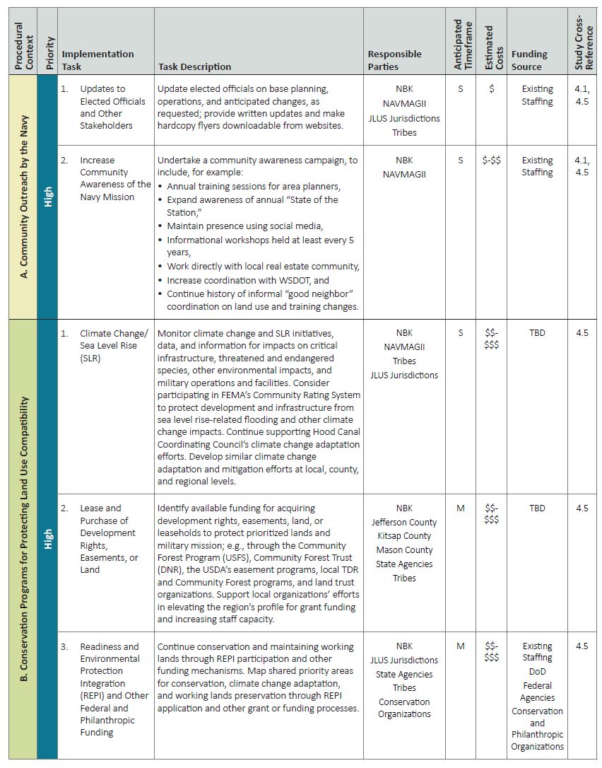
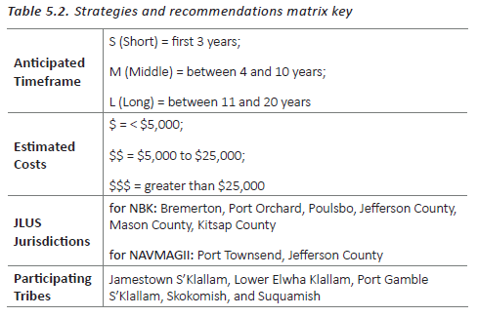
Strategies
and
Recommendations
Matrix
Notes:
They are intended to guide JLUS implementation and help the community prioritize that implementation effort
For each implementation task – the matrix indicates:
Priority level
the Agencies or parties affected by or responsible for implementing the tool
anticipated time frame – refer to key
estimated cost - refer to key
possible funding source
cross reference to JLUS analysis on issue

Slide 24
Next Steps
Phase 2: Development of recommendations (?)
Newly-forged relationships and understanding that will carry coordination to another level
Questions?
Kathlene Barnhart
Senior Planner
Kitsap County, DCD
kbarnhar@co.kitsap.wa.us
(360)337-4601

