Slide 1
Planning for Climate Change
Peninsula Section Conference
September 25, 2015
Bremerton, WA
Jill Sterrett, FAICP
Joyce Phillips, AICP

Slide 2
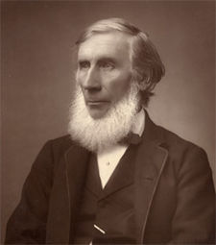
The Science of Climate Change
1859 - John Tyndall discovers that some gases block infrared radiation.
He suggests that changes in the concentration of the gases could bring climate change.
.

Slide 3
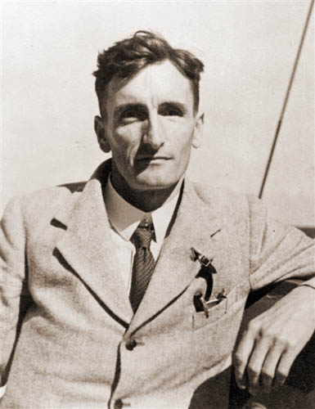
The Science of Climate Change
1938 – Guy Callendar publishes The Artificial Production of Carbon Dioxide and its Influence on Temperature.
Links upward trends in early 20th century global temperatures to increasing concentrations of atmospheric CO2 and fossil fuel combustion

Slide 4
Climate Change Defined
Climate Change
“A change in the state of the climate that can
be identified by changes in the mean and/or
variability of its properties and that persists for an extended period, typically decades or longer.”
(IPCC Glossary)

Slide 5
Emissions by Sector for Washington State
Million Metric Tons of CO₂ by sector
Other
15 mmt
15%
Transportation
42.5 mmt
46.2 %
Electricity
15.2 mmt
16.5%
RCI
20.5 mmt
22.3%
RCI = Residential, Commercial & Industrial building use
Source: Washington State Department of Ecology, Washington State Greenhouse Gas Emissions Inventory 2011-2012 report
Notes:
The transportation sector is where the majority of our state emissions are generated. Another 22 percent come from heating, cooling, lighting, and powering our buildings. In sum, that is almost 70% of our state’s emissions. The good news is that through planning we can work to substantially reduce the amount of greenhouse gas emissions.

Slide 6
Observations
Increasing carbon dioxide levels.
Warmer air temperatures.
Drier summers and reduced snowfall.
Rising sea levels
More frequent and severe extreme weather events.
More acidic marine waters.
Warmer water temperatures.
Source: http://www.ecy.wa.gov/pubs/1201004e.pdf

Slide 7
Projections
Drier, hotter weather causing droughts
Coastal flooding from rising sea levels
Increasing frequency and severity of wildfires due to drier summers
Increasing frequency and severity of flooding from earlier snow melt and increased spring rains

Slide 8
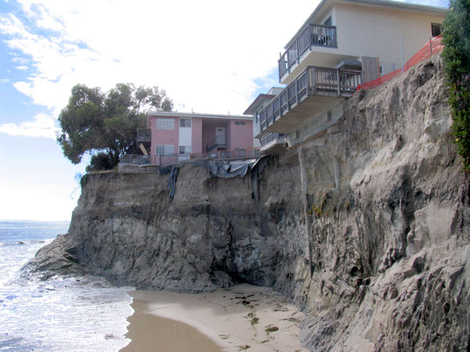
Near-term Challenges of SLR
Sea level rise increases storm surge and the risk of:
flooding,
erosion,
habitat loss
These impacts will affect coastal areas long before permanent inundation.
Notes:
While permanent inundation of low-lying areas is what people most associate with sea level rise, it is important to recognize that sea level rise has many near term episodic impacts that will increase in frequency, intensity, and/or magnitude, including flooding, erosion, habitat loss.
Photo: http://soundwaves.usgs.gov/2008/07/CliffLV1cvPLSLG.jpg

Slide 9
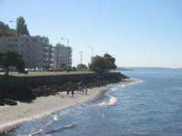
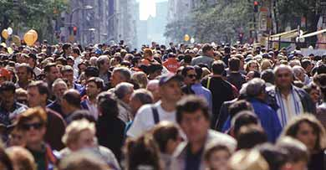
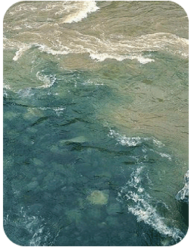
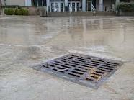
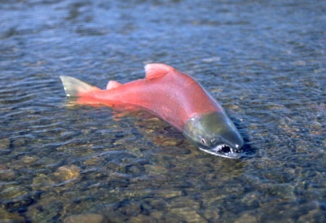
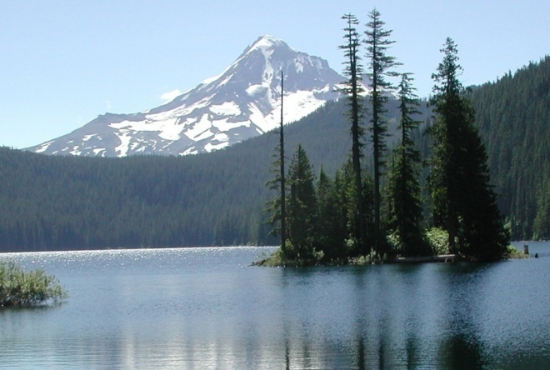
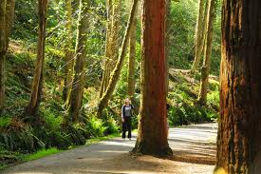
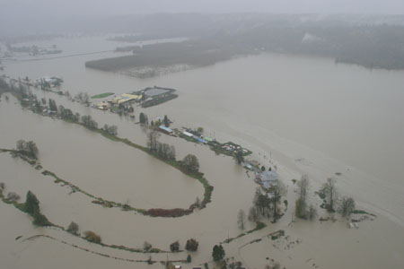
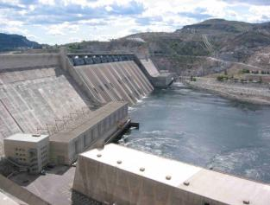
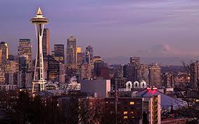
Long Term Challenges to Local Government Services and Functions
Public Health
Water Quality
Stormwater Management
M&I Water Supply
Natural Areas Mngmt
Environmental Protection
Flood Management
Energy Supply
Economic Development
Notes:
And we know that many of the areas affected by climate are related directly or indirectly to important local government services and functions.
This is by no means a comprehensive list….others: emergency management, transportation, planning & zoning, RSJ

Slide 10
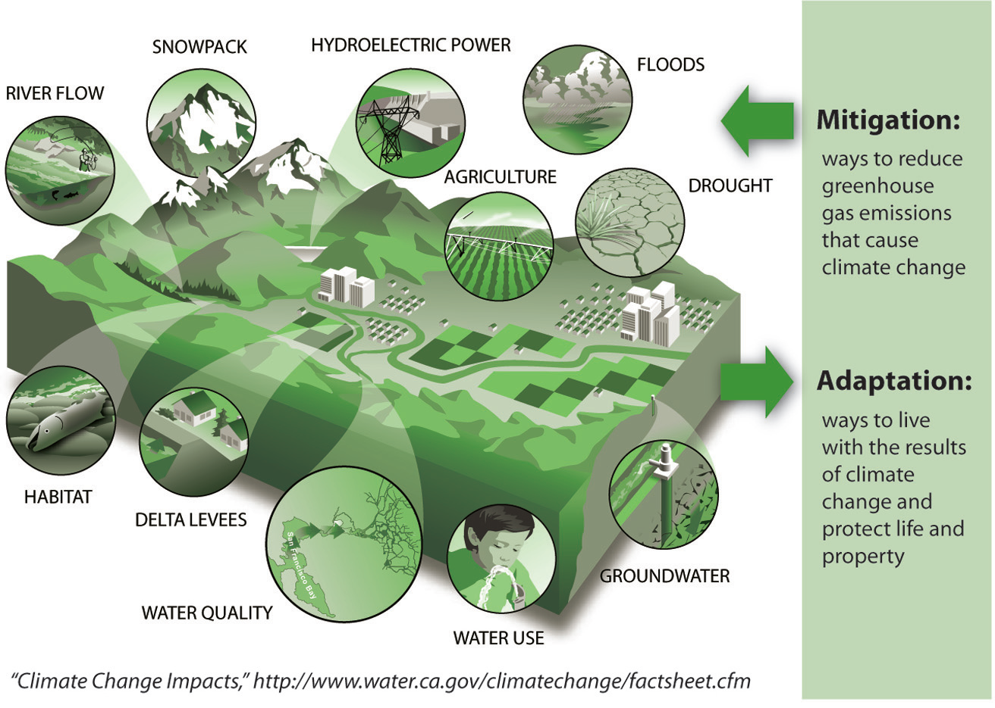
Two Pronged Response

Slide 11
RCWs in addition to the GMA
Washington State enacted statewide limits (RCW 70.235.020) on greenhouse gas emissions, which reduce over time.
The state has adopted a statewide goal (RCW 47.01.440) to reduce annual per capita vehicle miles traveled for light duty vehicles.
Comprehensive planning is an excellent venue to address both the reduction of greenhouse gases and vehicle miles traveled.
Notes:
The state shall limit emissions of greenhouse gases to achieve the following emission reductions for Washington state:
By 2020, reduce overall emissions of greenhouse gases in the state to 1990 levels;
By 2035, reduce overall emissions of greenhouse gases in the state to twenty-five percent (25%) below 1990 levels;
By 2050, the state will do its part to reach global climate stabilization levels by reducing overall emissions to fifty percent (50%) below 1990 levels, or seventy percent below the state's expected emissions that year.
Establish the following benchmarks using a statewide baseline of seventy-five billion vehicle miles traveled less the vehicle miles traveled attributable to vehicles licensed under RCW 46.16A.455 and weighing ten thousand pounds or more, which are exempt from this section:
Decrease the annual per capita vehicle miles traveled by eighteen percent (18%) by 2020;
Decrease the annual per capita vehicle miles traveled by thirty percent (30%) by 2035; and
Decrease the annual per capita vehicle miles traveled by fifty percent (50%) by 2050;

Slide 12
Executive Order 14-04
“The Departments of Transportation, Commerce, and Ecology will work with the Regional Transportation Planning Organizations, counties, and cities to develop a new program of financial and technical assistance to help local governments implement measures to improve transportation efficiency, and to update their comprehensive plans to produce travel and land-use patterns that maximize efficiency in movement of goods and people, and reduce costs and greenhouse gas emissions.”
(emphasis added)
http://www.governor.wa.gov/sites/default/files/exe_order/eo_14-04.pdf
Notes:
Department of Health has joined this partnership. State agencies are working to develop and share guidance. WSDOT has been meeting with the RTPOs. Reaching out to local governments (survey, engagements such as today) to seek input on what would be helpful for you.
A new webpage is being developed that will include Transportation Efficient Community resources from all four state agencies.

Slide 13
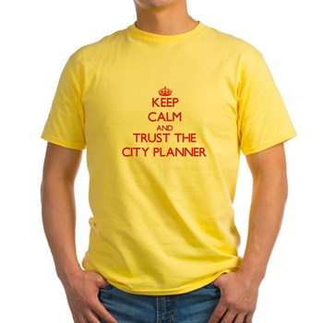
What Can Planners Do?
Opportunities to Reduce Emissions and Climate Impacts through planning:
Land Use
Transportation
Energy
Health and Equity
Vulnerability Assessments

Slide 14
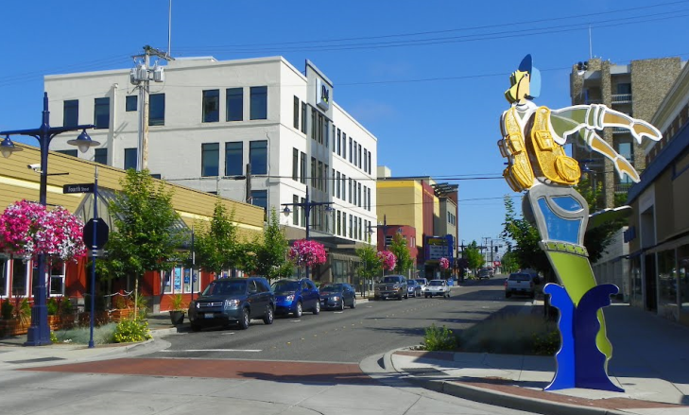
Mitigation Measures
Land Use
Compact Urban Growth Areas
Mixed Uses
Walkable Downtowns
Promote Infill
Transit Oriented Development
Parking (cost & supply)
EV Infrastructure
Plans & Codes

Slide 15
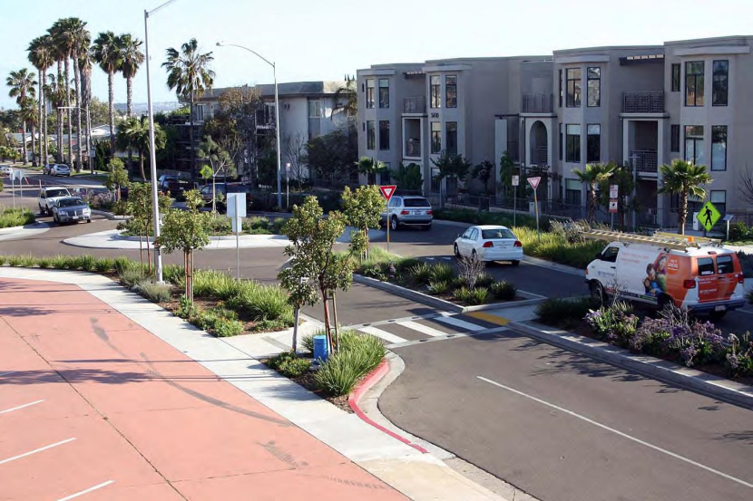
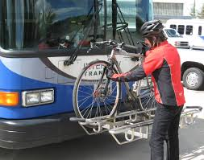
Mitigation Measures
Transportation
Support Transit
Regional Trails
Complete Streets
Mid-Block Crossing in some locations
Multi-modal Level of Service Standards
Demand Management
Fill gaps & connect modes

Slide 16
Mitigation Measures
Government
Energy
Fleet
Building & Grounds Operations
Street Lights
Energy Audits ~ reinvest savings into more improvements
Support Renewable Energy (rooftop solar)
Energy Codes
Solar Ready Construction
Public Buildings (schools, libraries, etc.)

Slide 17
What Does it Mean to “Adapt to Climate Change”?
Adaptation
Taking steps to avoid or minimize known climate change impacts while increasing the ability of human and natural systems to “bounce back” from the impacts that cannot be avoided (or anticipated).
Notes:
Rather than making communities climate proof, preparing for climate change is about increasing resilience to climate change impacts.
Quote taken from Adger, W.N., N.W. Arnell, E.L. Tompkins. 2005. Successful adaptation to climate change across scales. Global Environmental Change 15: 77-86.

Slide 18
Climate Change Video
https://youtu.be/Jz-QP8BA-9c

Slide 19
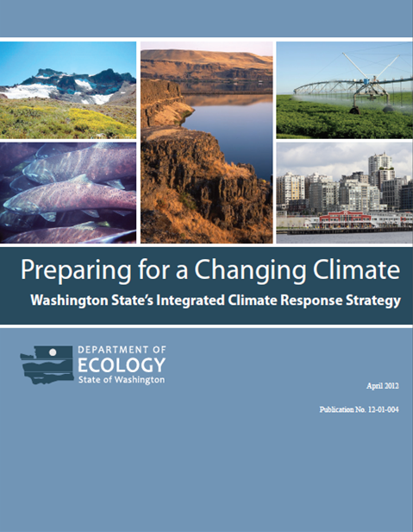
Adaptation
New White House Task Force Recommendations are consistent
Integrates many issues
Observed Trends and Future Projections
Human Health
Ecosystems, Species, & Habitats
Ocean and Coastlines
Water Resources
Agriculture
Forests
Infrastructure & the Built Environment
Research and Monitoring
Communication, Public Awareness, and Engagement
Washington is one of only a few states with a response strategy

Slide 20
Vulnerability Assessments
Which – Understand which threats to your community
Where (specific location like flooding around a stream or area wide impacts like urban heat islands)
Who – which groups are most affected?
What – what is most critical to protect (public buildings, infrastructure, etc.)
Timeframes – plan for continuing change
Direct growth away from specific impact areas
Responses (protect, retreat, abandon)

Slide 21
Vulnerability Assessment Examples
WSDOT (qualitative assessment of state-owned transportation assets for all climate risks)
Sound Transit
Swinomish Tribe
Vulnerabilities & Risks
Climate Action Plan
Grays Harbor – Flood Risks across the county with recommendations for each city based on their vulnerabilities
Assess risks from the impacts you believe are most likely, likely to occur first, or that would have the biggest impact on your community.

Slide 22
Extreme Heat Events
http://www.globalchange.gov/components/com_joomgallery/img_originals/global_climate_change_impacts_in_the_united_states_1/human_health_9/human_health_4_20090707_1990514532.jpg
https://fortress.wa.gov/ecy/publications/publications/1201004e.pdf
Notes:
Extreme Heat Events is one aspect from the Extreme Weather paper. Because cities have so much asphalt and concrete, and less grass and vegetation, they absorb and hold heat, which is then radiated back out after the sun goes down. As a result, cities are warmer during the day and do not cool off as much at night when compared to suburban or rural areas. There are several adaptation strategies they can use to help prevent or reduce impacts when heat waves hit.

Slide 23
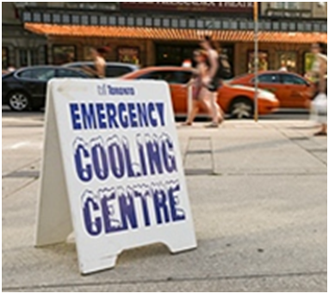
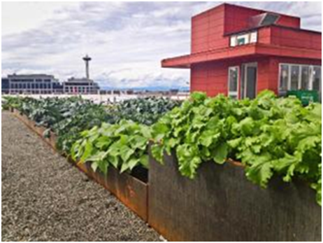
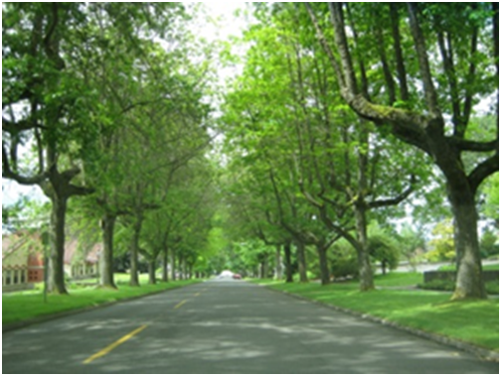
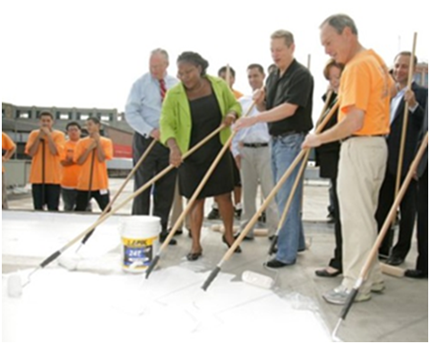
Extreme Heat Adaptation
Cooling Centers
Green Roofs
Cool Roofs
Urban Forestry
Notes:
Some of these examples can be short term, such as opening cooling centers during a heat wave, while others such as increasing tree canopy in our cities are long term strategies that also provide other benefits. Rooftop agriculture or green roofs also provide co-benefits such as urban food sources or stormwater benefits. Cool roofs, which basically entails painting roofs a white or light reflective color, are really fairly simple.

Slide 24
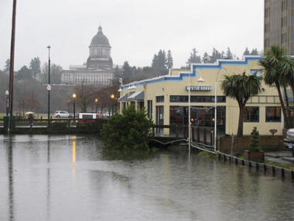
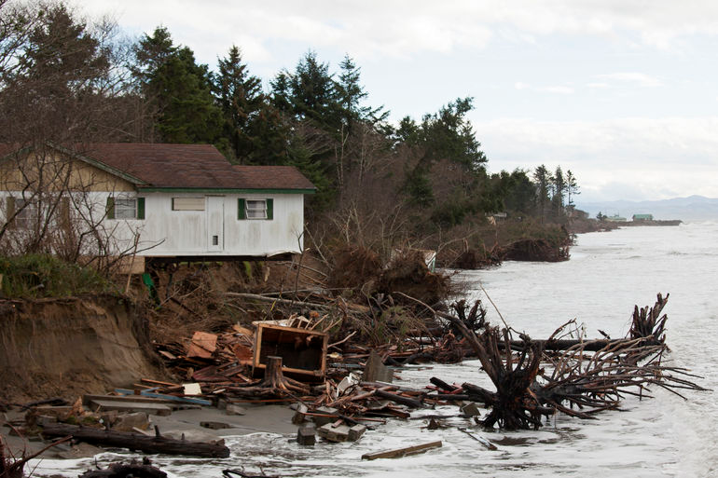
Sea Level Rise Adaptations
Defend
Retreat
Abandon
Year | Puget Sound | Northwest Olympic Peninsula | Central and Southern Outer Coast
2050 | +3 to +22 inches | -5 to +14 inches | +1 to +18 inches
2100 | +6 to +50 inches | -9 to +35 inches | +2 to +43 inches
Source: Chapter 3, Oceans and Coastlines, Washington State Integrated Response Strategy
Notes:
Sea Level Rise is an interesting issue in Washington state. Because of our on-going dynamic geologic processes, some areas are not anticipated to have as much of an impact when compared to other parts of the state. This is because in some areas of our state, the land is still rising, while other areas are subsiding. Sea Level Rise could impact ports and commerce, infrastructure, and could accelerate coastal erosion.
The paper provides information on the topic, tools for assessing impacts, and provides examples of local communities in our state that are considering sea level rise impacts.
Affected communities will eventually need to decide when to protect assets, when to retreat back or at higher elevations, or when to abandon certain investments so they can be relocated out of the impacted areas. Because these investments can often be millions of dollars, knowing when impacts are likely and to what extent, communities can make the best decisions for how to proceed.
http://www.komonews.com/communities/olympia/196011111.html
http://www.msnbc.com/msnbc/west-coast-hit-hard-pineapple-express-storm
Photos: Right - Olympia, WA downtown during King Tides event. Left – Washaway Beach, Pacific County, WA

Slide 25
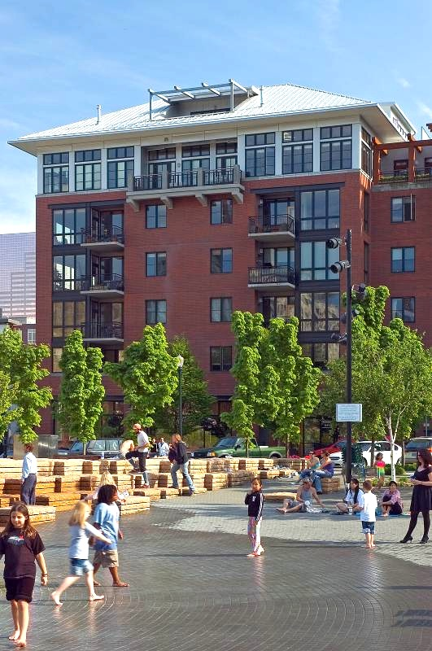
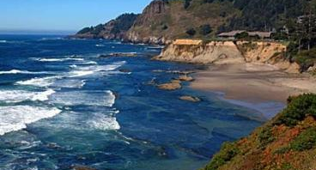
Planning Resilient Communities
Opportunities to Adapt
Understand and Plan for Local Risks
Direct Growth to Safer Areas
Wise Infrastructure Investments
Opportunities for Mitigation
Clean Fuels, Clean Cars
Green Building Practices, Materials
Walk, Bike, Use Transit
Renewable Energy
Help Your Community – Be the Change!

Slide 26
Planning for Uncertainty
“No regrets” strategies
Provides benefits now with or without climate change
“Low regrets” strategies
Provide climate change benefits for little additional cost or risk
“Win-win” or “Co-benefit” strategies
Reduce climate change impacts while providing other environmental, social, or economic benefits

Slide 27
Resources for Washington
WA-APA Ten Big Ideas For Washington’s Future at: http://www.washington-apa.org/ten-big-ideas
Transportation Efficient Communities: Coming Soon!
Climate Change & Energy: http://www.commerce.wa.gov/Services/localgovernment/GrowthManagement/Growth-Management-Planning-Topics/Climate-Change-and-Energy/Pages/default.aspx
Preparing for a Changing Climate: Washington State’s Integrated Response Strategy at: http://www.ecy.wa.gov/climatechange/ipa_responsestrategy.htm

Slide 28
Thank You!
Jill Sterrett, FAICP
University of Washington
Affiliate Faculty
jill.sterrett@gmail.com
206-819-6062
Joyce Phillips, AICP
Washington State Department of Commerce
Senior Planner
joyce.phillips@commerce.wa.gov
360-725-3045

Slide 29
Questions?
Planning for Climate Change

Slide 30
The Pope on Climate
Think of future generations
Embrace alternative energy sources
Consider pollution’s effect on the poor
Take the bus!
Be humble
Don’t become a slave to your phone
Don’t trade online relationships for real ones
Turn off the lights, recycle, and don’t waste food
Educate yourself
Believe you can make a difference

